Slide 1
18ECO134T – Sensors and Transducers
Unit IV : Session 8 : SLO 1
SRM Institute of Science and Technology
1
Notes:
Pl use Font Family : Arial Narrow
To enhance the teacher presentations and the overall comprehension of students, it allows to present their lessons in a more dynamic and effective way. Set a Learning Objective:
1. Write an Outline for Key Ideas
2. Give the Presentation About Education a "Why"
3. Share Techniques and Tips for the Topic
4. Teach With Visualizations
5. Use Animations Carefully
1

Slide 2
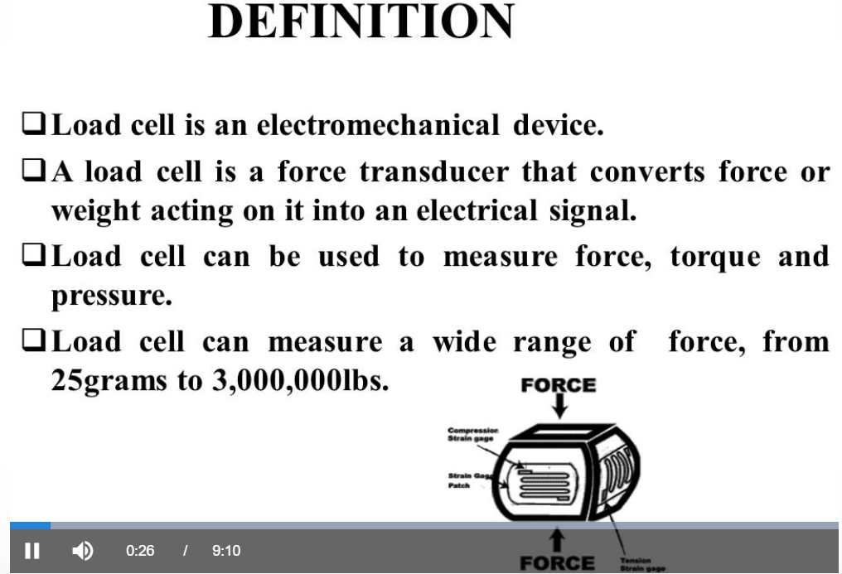
LOAD CELLS

Slide 3
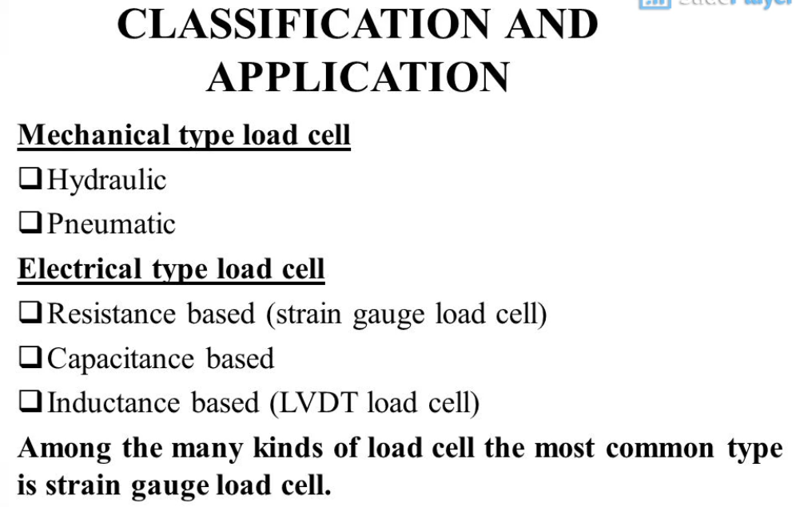

Slide 4
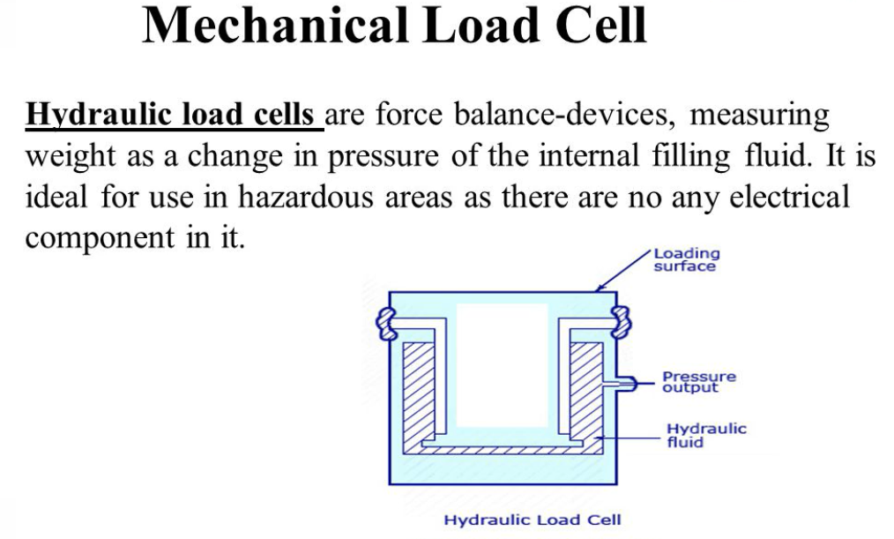

Slide 5


Slide 7
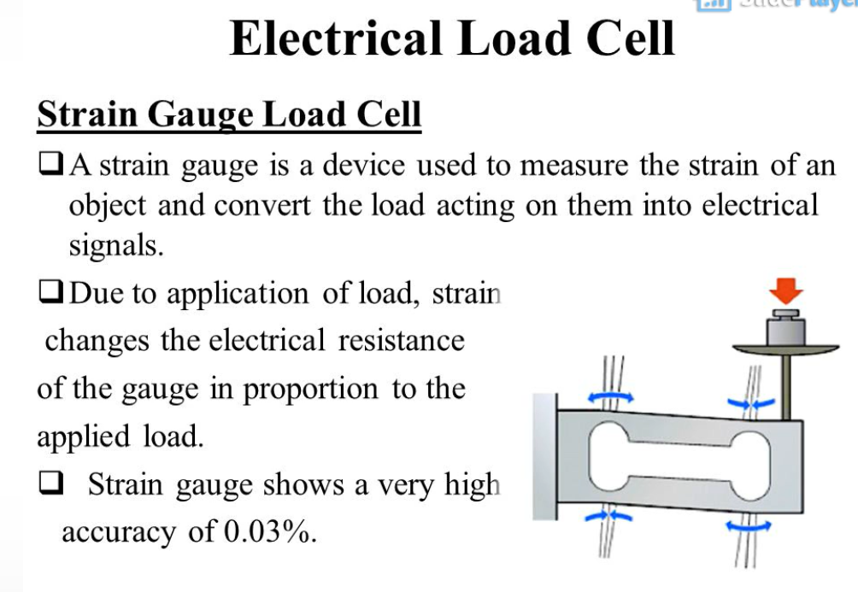

Slide 8
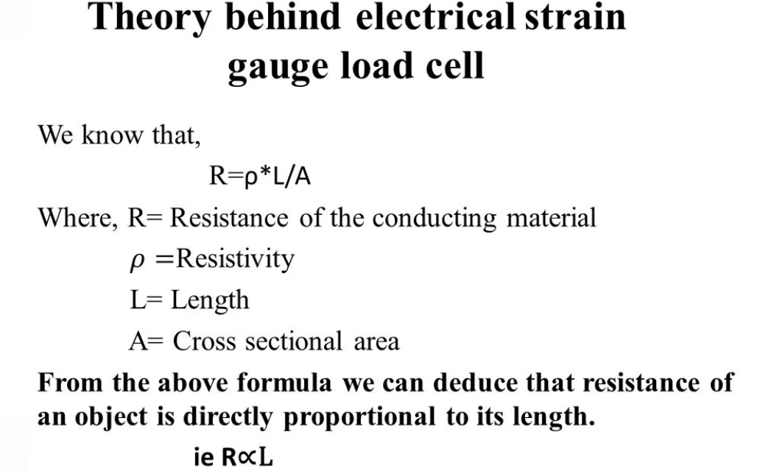

Slide 9
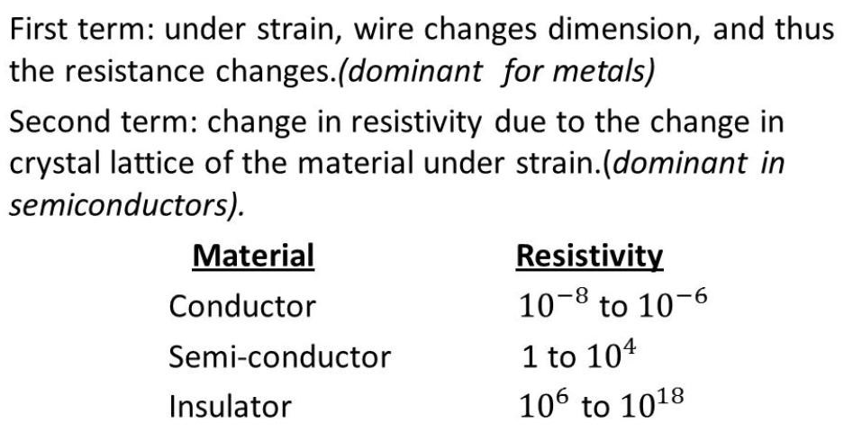

Slide 10


Slide 11
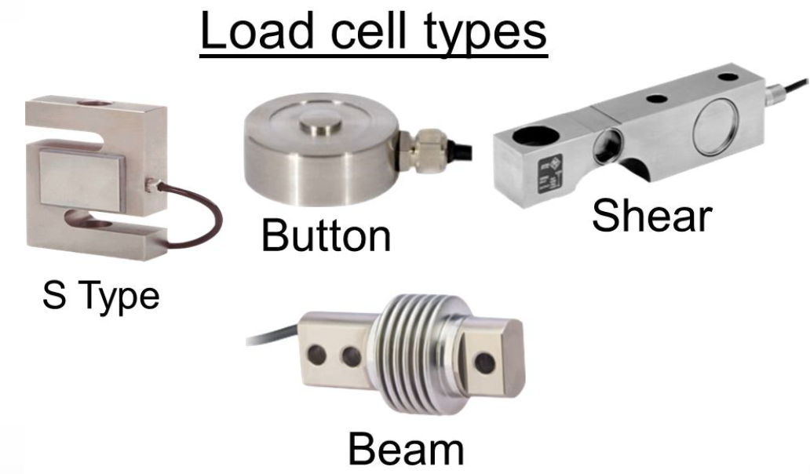

Slide 12
